Slide 1
Towards a background probability map for vent opening position in a future Plinian-subPlinian eruption of Somma-Vesuvius, with structured uncertainty assessment
Alessandro Tadini
Bevilacqua A., Neri A., Cioni R., Aspinall W.P., Bisson M., Isaia R., Valentine G.A., Vitale S., Baxter P.J., Bertagnini A., Cerminara M., De Michieli Vitturi M., Di Roberto A., Engwell S., Esposti Ongaro T., Mazzarini F., Pistolesi M., Todde A. & Russo A.
Firenze – 02/09/2015

Slide 2
Outline
Datasets description
Spatial uncertainties
Probability density maps
Vent opening probability maps with single datasets
Structured Expert Judgement
Preliminary vent opening probability map
Effect of caldera enlargement in case of a Plinian eruption

Slide 3
Preliminary definitions/assumptions
Somma-Vesuvius (SV) Caldera
Morphological constraints:
Foot of Mt. Somma scarp (N-NE)
Limit of Piano delle Ginestre and Valle dell’Inferno (W-S-SW)
Surface: 12.98 km²
Next Plinian/Subplinian eruption will reasonably take place within the SV caldera (past distribution of Explosive activity at SV is confined within this area) BUT
Several episodes of volcanic activity (effusive) outside SV caldera (probability for next eruption to be placed outside SV caldera?)

Slide 4
Datasets for SV vent opening probability maps/1
8 datasets/variables
Distribution of PLINIAN/SUBPLINIAN I-II eruptions
PLINIAN eruptions (4 events – 22 ky BP>Age>AD 79);
SUBPLINIAN I-II eruptions (6 events – 19 ky BP>Age>AD 1631);
Distribution of VIOLENT STROMBOLIAN (VS) to CONTINUOUS ASH EMISSION (AE) eruptions;
Within the whole SV caldera (22 ky BP>Age>3.9 ky BP)
Within the Gran Cono area (22 events – 3.9 ky BP>Age>AD 1631)
Within the 1944 Crater Rim area (10 events – AD 1631>Age>AD 1944)
Distribution of EFFUSIVE eruptions (AD 1631>Age>AD 1944)
Parasitic vents (46 mapped, 47 ‘lost’);
Eruptive fissures (‘High-density’ area);
Distribution of DEEP FAULTS (Quaternary? – 3 faults crossing SV caldera);
1 Homogeneous distribution (Accounts for neglected factors and missing information)
Each feature has been attributed an uncertainty area that reflect spatial uncertainties in feature location. Areas have been defined according to:
Morphological constraints (Plinian eruptions)
Temporal constraints/Field evidences (Subplinian eruptions, VS to AE eruptions, Effusive eruptions)
Resolution limits of interpolation profiles (Deep Faults)

Slide 5
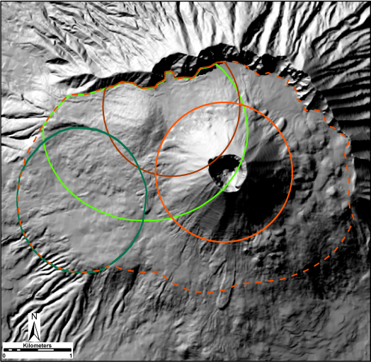
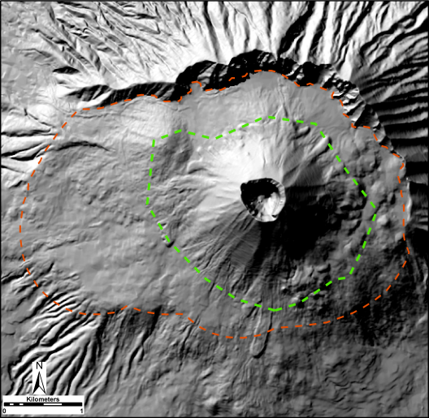
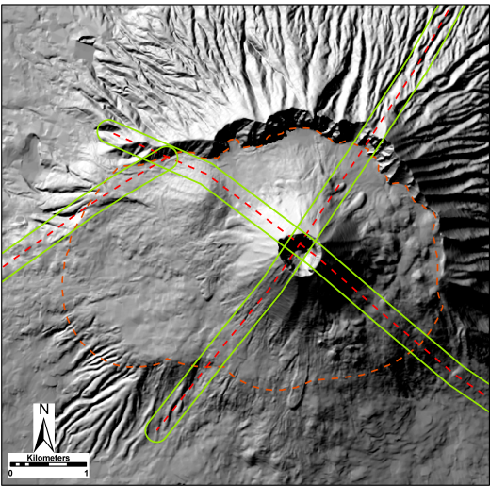
Datasets for SV vent opening probability maps/2
UNCERTAINTY AREAS
PLINIAN
SUBPLINIAN
VS to AE - CALDERA
VS to AE – GRAN CONO
VS to AE – 1944 CRATER
PARASITIC VENTS
ERUPTIVE FISSURES
DEEP FAULTS

Slide 6
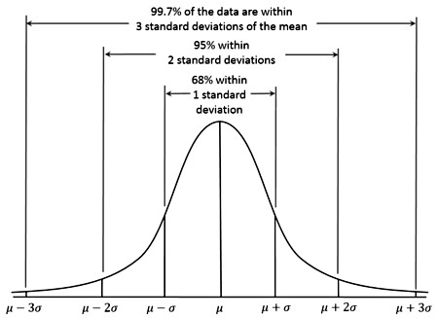
PROBABILITY DENSITY FUNCTIONS: Gaussian kernels/1
Variables can be used for the numerical generation of single probability distributions (PD) of vent opening (VO) obtained from them.
VO maps were derived from the application of a Gaussian kernel to the uniform PD – the resultant distribution will spread a small amount of probability outside the boundary of the uncertainty area as a function of the bandwidth chosen
The bandwidths of the Gaussian kernels are:
for Plinian/Subplinian eruptions and Parasitic effusive vents the mean minimum distance between the centroids of the uncertainty areas;
for Deep faults an estimate of the average damage zone (DZ) width;
for VS to AE (Crater and Gran Cono) eruptions and Eruptive fissures a fixed value of 100 m (the cell size).

Slide 7
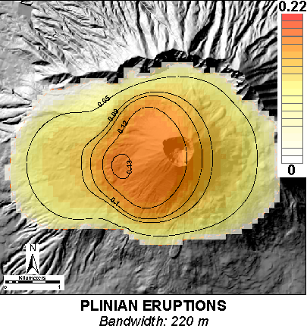
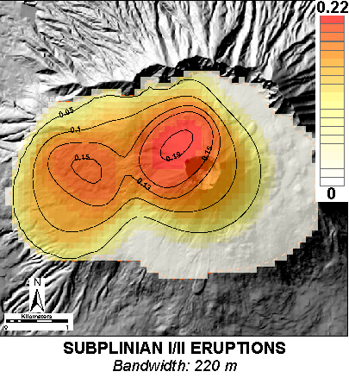
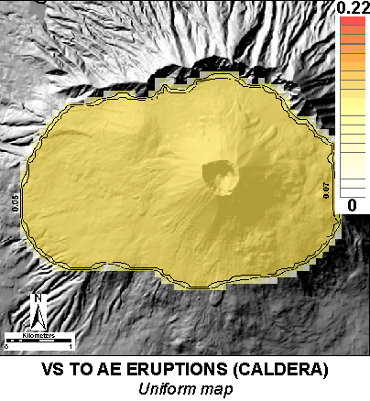
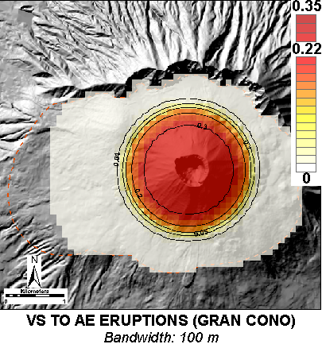
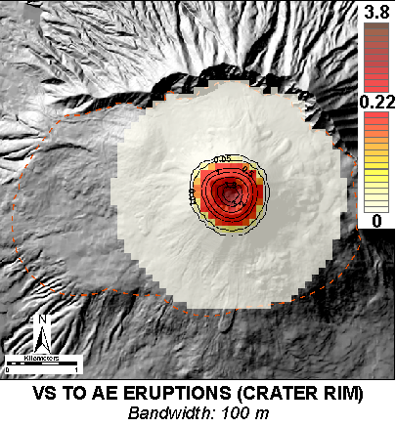
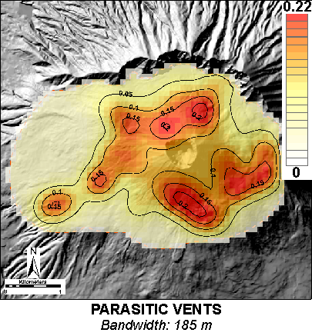
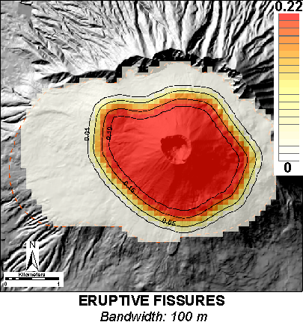
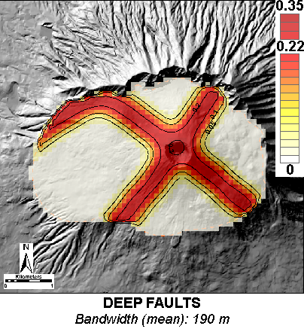
PROBABILITY DENSITY FUNCTIONS: Gaussian kernels/2

Slide 8
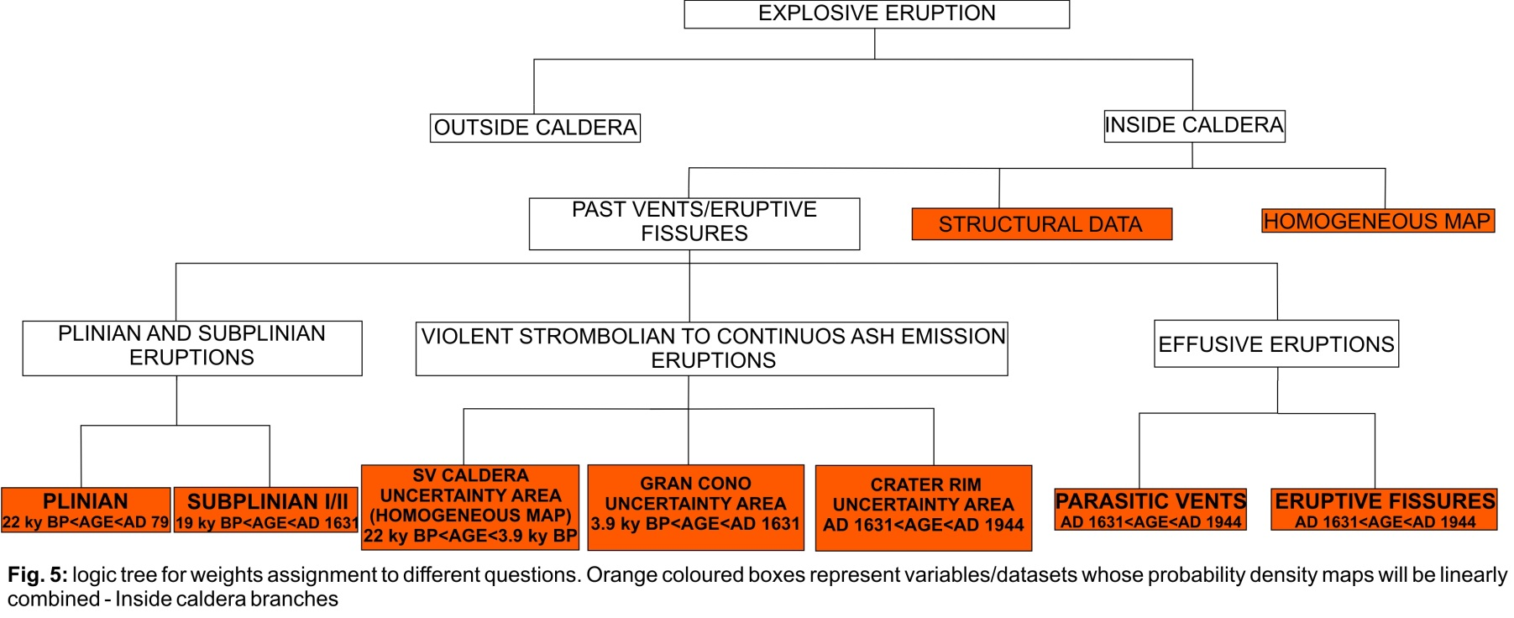
Structured expert judgement
Three different judgement scoring procedures have been applied to the elicitation data: Classical Method (CM), Expected Relative Frequency method (ERF), and Equal Weights rule (EW).
CM and EW metrics assume the experts’ central values are the median values of maximum entropy distributions, while ERF assumes they are modal values of triangular distributions.
17 Experts were invited to provide their judgements on 16 seed items for calibration scoring purposes.
For calculating location uncertainty estimates, the different decision maker assessments were implemented in a logic tree structure for the target questions through Monte Carlo simulation.
Each expert responded to 15 target items for providing weights that needs to be attributed the different VO maps related to previous variables.
6-10%
Sensitivity analyses were performed by removing controversial seed questions and by considering sub-groups of experts (Juniors/Seniors, Geologists/Modelers)
Agreement between weights/maps among different scoring procedures and different sub-groups (weights differ maximum for 3%) – CM maps with all the experts considered as a reference

Slide 9
PRELIMINARY Vent opening probability maps
5th
5th
Mean
Mean
95th
95th
Maxima located in correspondence of the present Crater (values range from 0.17% up to 0.4%)
More pronunced effect of Deep Faults on mean map and 95th percentile map (effect of high skeweness toward higher values of weight attributed to this dataset by the experts)
Values of probabilities for different caldera sectors
Sector A (Gran Cono): 43.9%
Sector B (Valle del Gigante): 15.7 %
Sector C (Valle dell’Inferno): 10.8 %
Sector D (Piano delle Ginestre): 29.6 %

Slide 10
Caldera enlargement
Possible caldera enlargement are due to the occurence of a Plinian eruption (probability that the next SV eruption is a Plinian one is 8.16% - see Neri et al. 2008)
The previous CM mean map has been applied a special kernel function («Pencil collapse») made by a circle with 1.3 km of radius (mean radius of past Plinian eruption collapsed areas) where the distribution of probability is 60% from the middle up to 0.25 km, 5% from 0.25 km to 1.05 km and 35% from 1.050 km to 1.3 km.
This special function reproduces the migration of volcanic vent during Plinian eruption at SV from the INITIAL VENT of the eruption in the middle up to the limit of the collapsing areas
Mean map on the left has been obtained by combining a CM mean map without caldera enlargement (that accounts for 92.84% of the weight) with a mean map that has been applied a caldera enlargement (that accounts for 8.16% of the weight)
This map represent a Preliminary vent opening probability map with also the probability of caldera enlargement conditional to the occurrence of a medium-large size eruption at SV
Probabilities of caldera enlargement are 1.5% (around 13% if the next eruption is a Plinian one): 0.73% toward N/NE, 0.31% toward S/SE and 0.43% toward W/NW.
No caldera enlargement are expected in case of a Sub-Plinian or lower magnitude eruption

Slide 11
Conclusions and future developments
Development of a geodatabase with distribution of past volcanic activity and structural features (Uncertainty areas)
Probability Density Functions for single datasets (Kernel functions with appropriate bandwidths)
Structured Expert Judgement for weights assignements to different datasets (different scoring methods – CM, ERF, EW)
Sensitivity analyses with sub-groups of experts (Juniors/Seniors, Geologists/Modelers) – agreement among experts
Preliminary vent opening probability map with caldera enlargement:
Initial vent outside SV caldera from 6% to 10%, caldera enlargement with 1-2% of probability
Revision of SV caldera enlargement
Calculation of new parameters (TGSD and Volume) for two Eruptive Units (EU3pf and EU4) from the AD 79 Plinian eruption
Use of new parameters for numerical modelling of PDCs to produce invasion maps that take into account Vent opening probability maps developed so far.

Slide 12
Thank you for your attention

